Slide 1
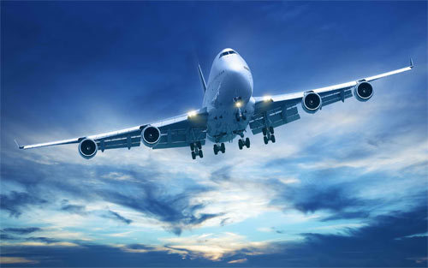
SO YOU WANT TO TAKE A FLIGHT? 2013-2018 AIRLINE PERFORMANCE TEN US BUSIEST AIRPORTS
Georgia Tech Data Science and Analytics Bootcamp
Team:
Saira Bhurjri
Hakan Demirojlu
Bruce Hart
Sean McCray
Meryem Ozcelik
Adrienne Thomas
October 13, 2018

Slide 2

Introduction
Purpose of the Project
Identify Data Sources and Data Collection
Strategy and Metrics, and Data Cleaning
Data Visualization/Analysis
Limitations and More Stuff if We Had More Time
Q&A
Notes:
How presentation will benefit audience: Adult learners are more interested in a subject if they know how or why it is important to them.
Presenter’s level of expertise in the subject: Briefly state your credentials in this area, or explain why participants should listen to you.

Slide 3
PURPOSE OF THE PROJECT
Provide passengers with information on airline performance as they consider flight options
Present analysis in meaningful ways for traveling public, airport and airline operators
Notes:
Lesson descriptions should be brief.

Slide 4
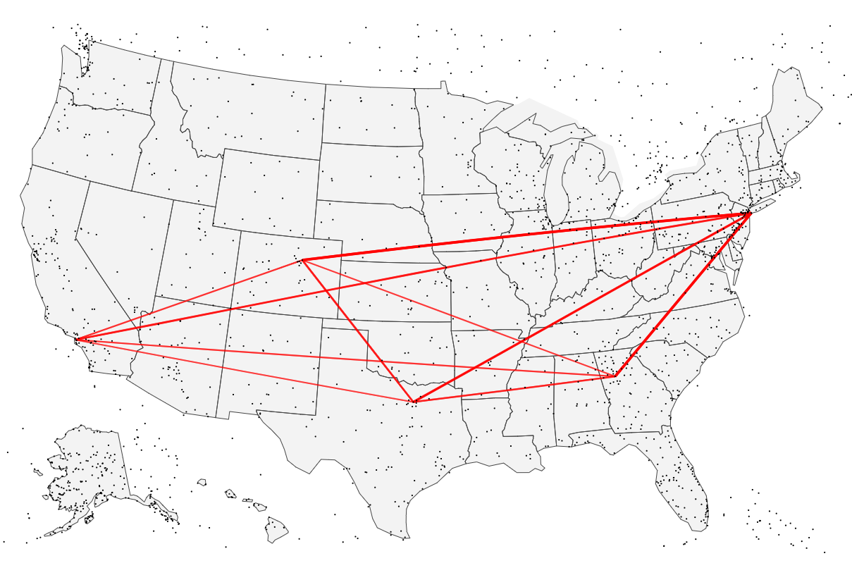
DATA VISUALIZATION/ANALYSIS

Slide 5
IDENTIFYING DATA SOURCES AND DATA COLLECTION
US Department of Transportation, Bureau of Transportation Statistics
“Reporting Carrier On-Time Performance” data table
Notes:
Example objectives
At the end of this lesson, you will be able to:
Save files to the team Web server.
Move files to different locations on the team Web server.
Share files on the team Web server.

Slide 6
STRATEGY AND METRICS, AND DATA CLEANING
Years: 2013-2018
US Airports (highest passenger volume): ATL, LAX, CHI, DFW, DEN, JFK
US Airlines:
began with 17 (American [AA], Delta [FL], United [UA], Southwest [WN], Spirit [NK], Airtran [FL], Alaska [AS], Endeavor [9E], Envoy [MQ], ExpressJet [EV], Frontier [F9], Hawaiian [HA], JetBlue [B6], Mesa [YV], Skywest [OO], USAirways [US], and Virgin America [VX])
Reduced to 10 busiest airlines (passenger volume)
Domestic flights
Data cleaning: merged various versions of BTS tables into one table for analysis (eliminated airlines and airports that didn’t include the target airlines and airports)

Slide 7
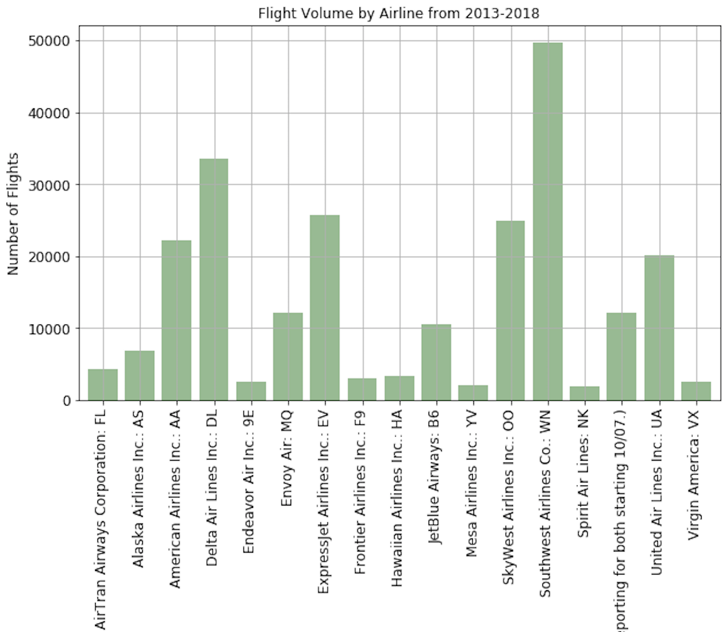
DATA VISUALIZATION/ANALYSIS

Slide 8
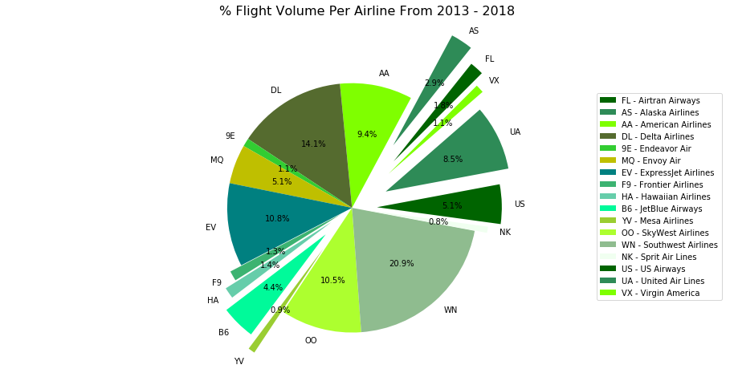

Slide 9
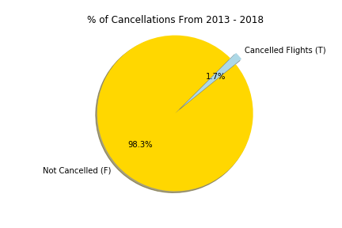

Slide 10
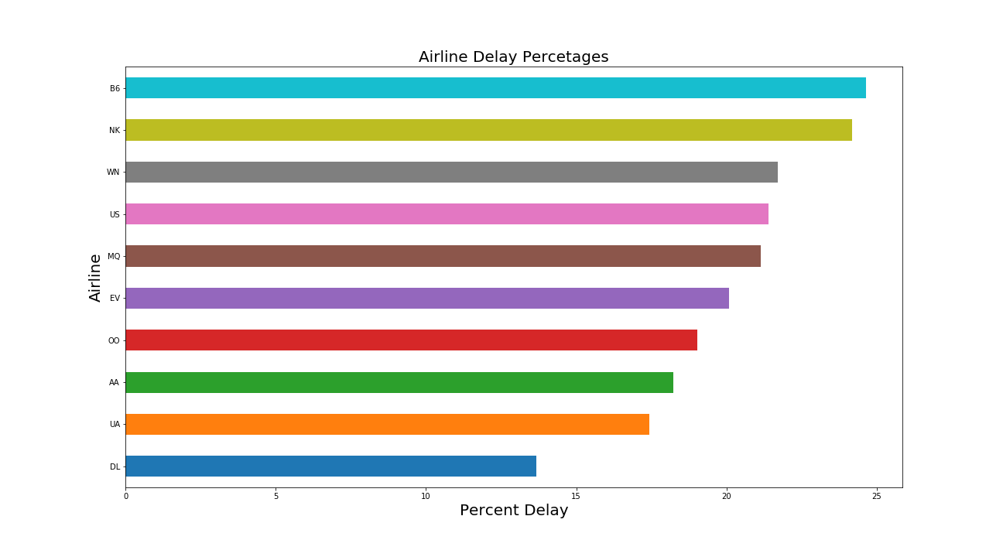

Slide 11
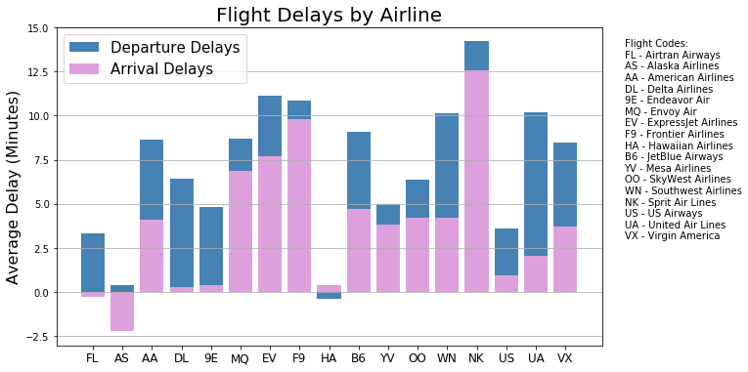

Slide 12
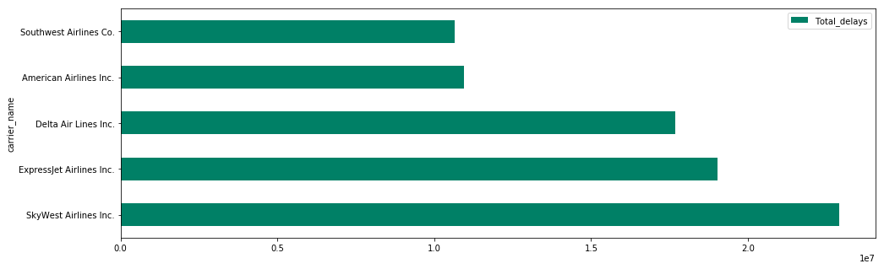
MINUTES OF DELAY BY AIRLINE

Slide 13
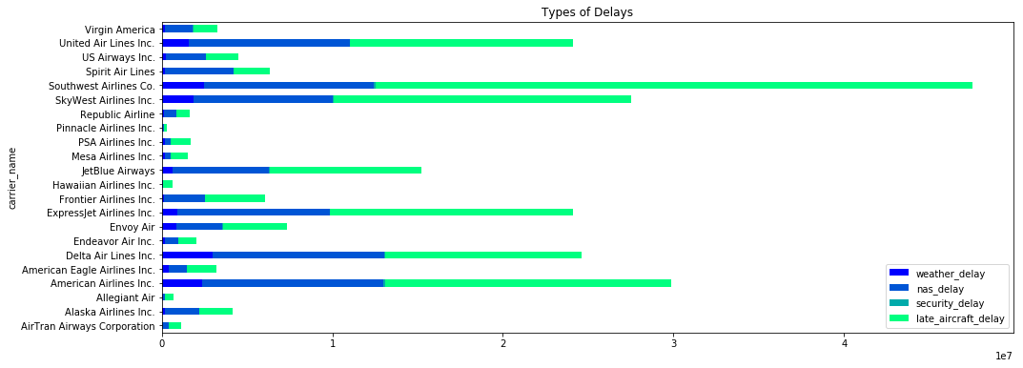

Slide 14
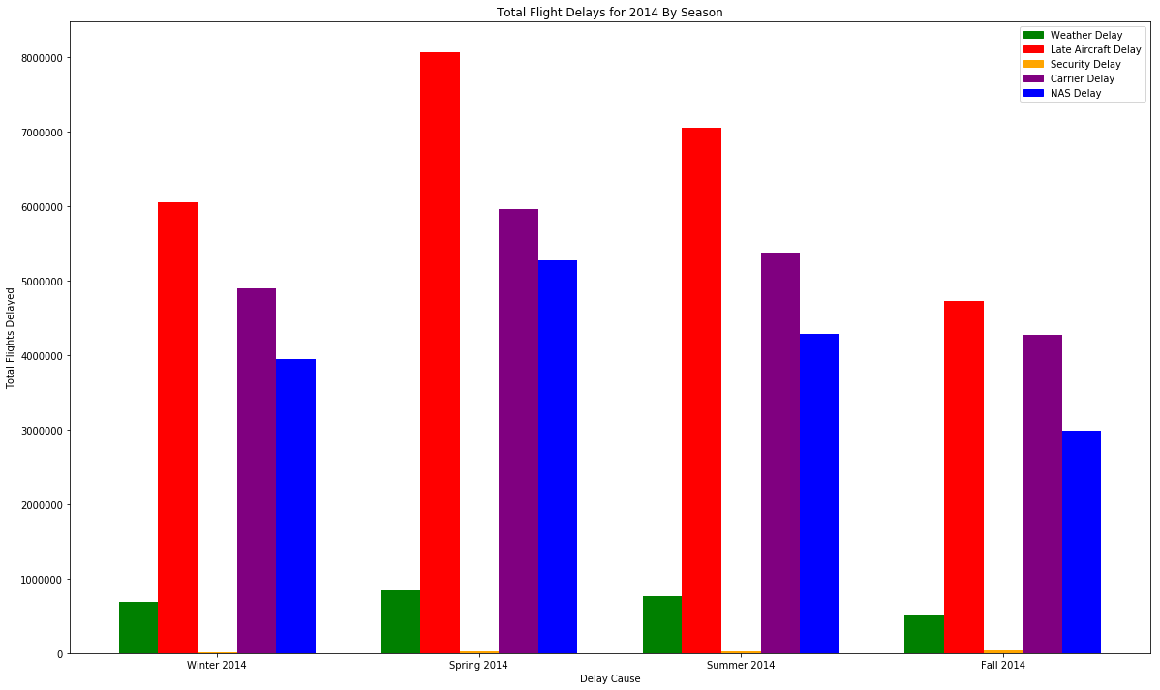

Slide 15
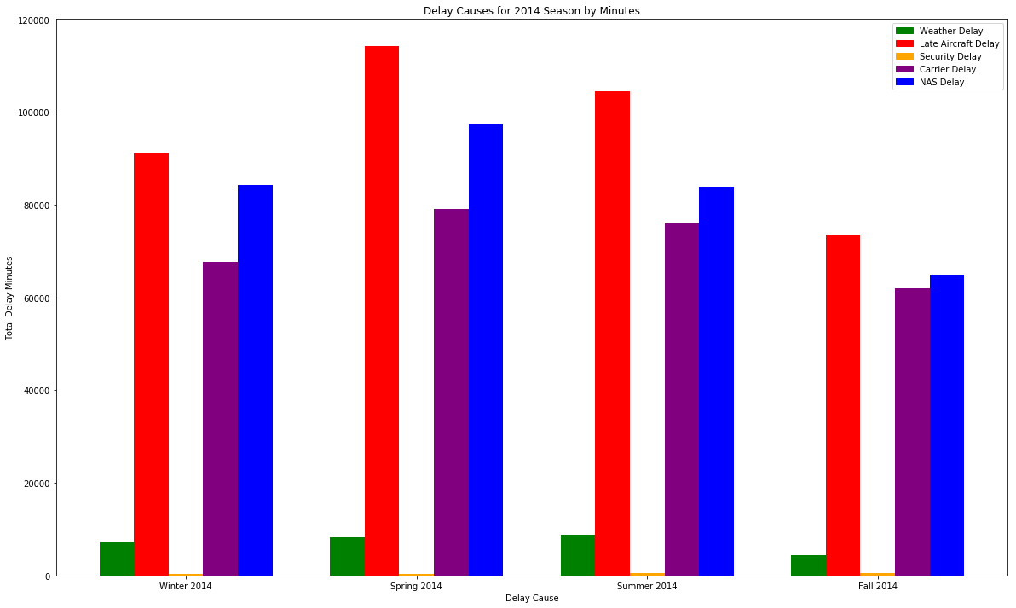

Slide 16


Slide 17
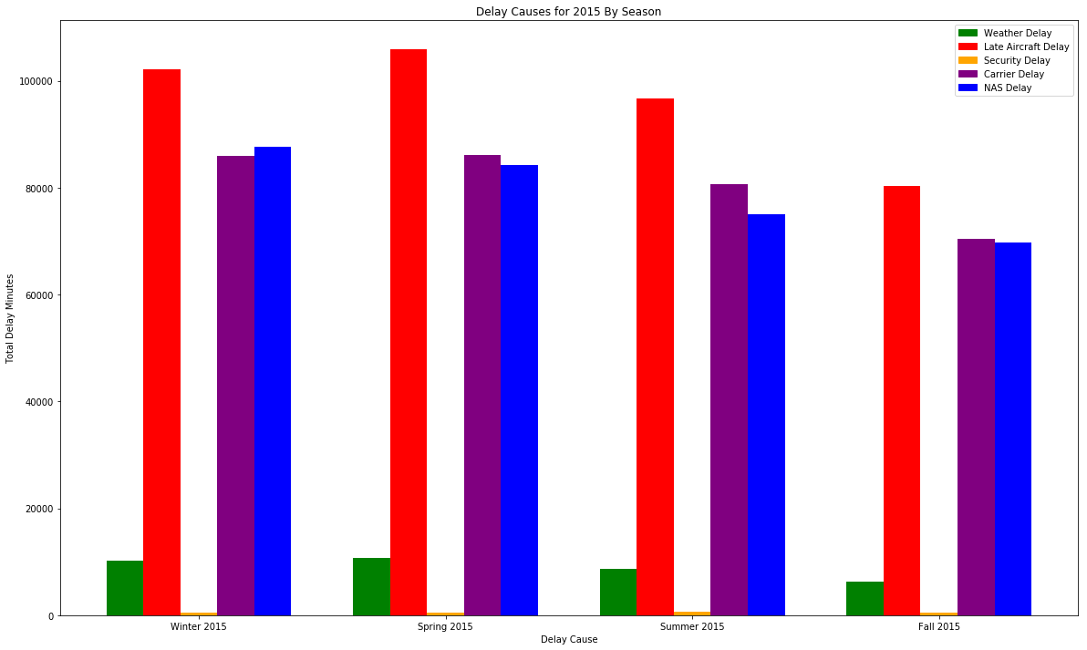

Slide 18


Slide 19
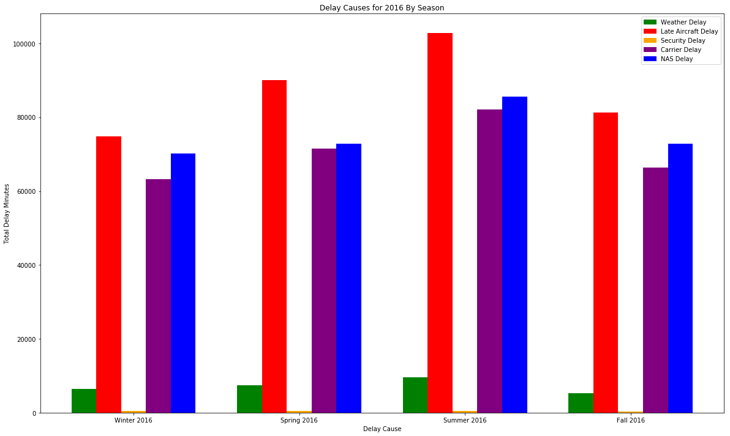

Slide 20


Slide 21


Slide 22
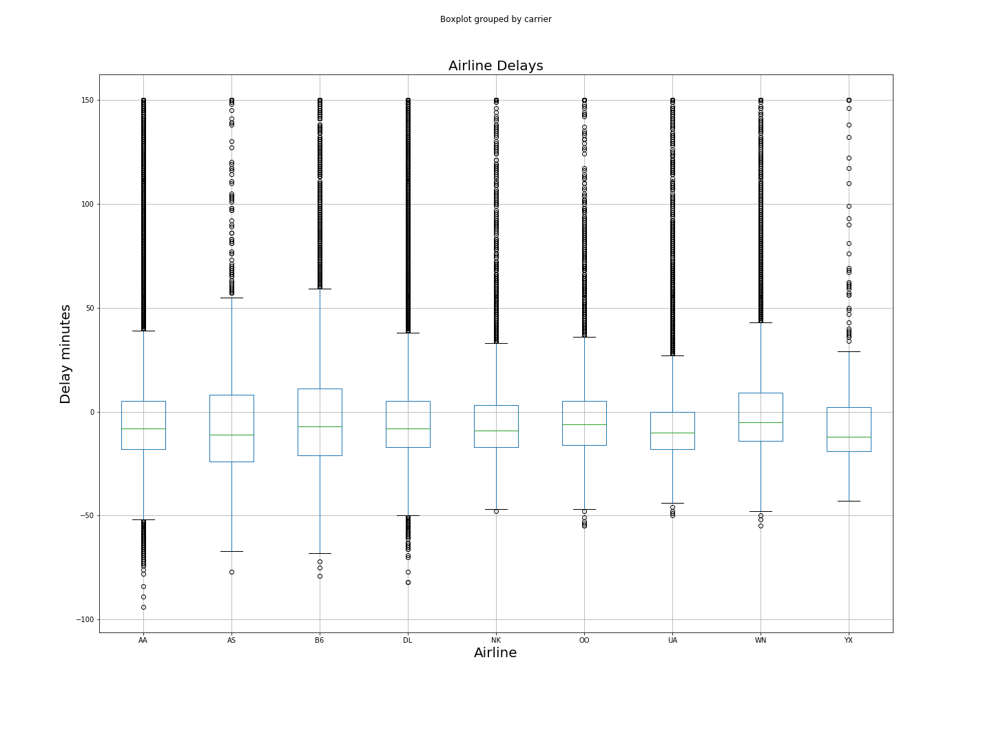
DELAY MINUTES OF AIRLINES

Slide 23
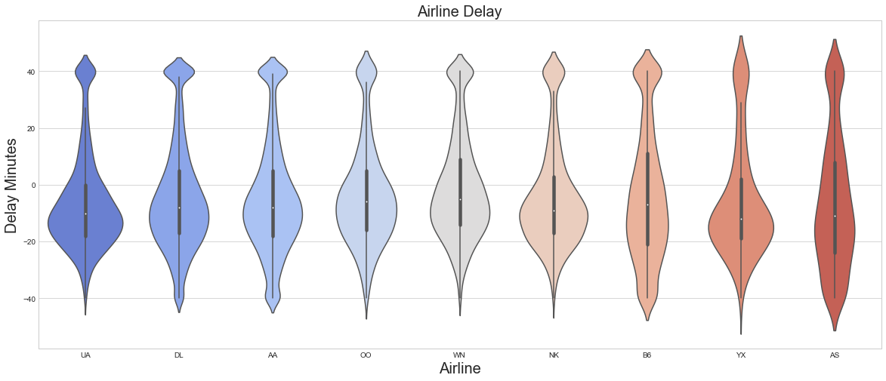
VIOLIN CHART – FREQUENCY OF DELAY MINUTES PER AIRLINE

Slide 24
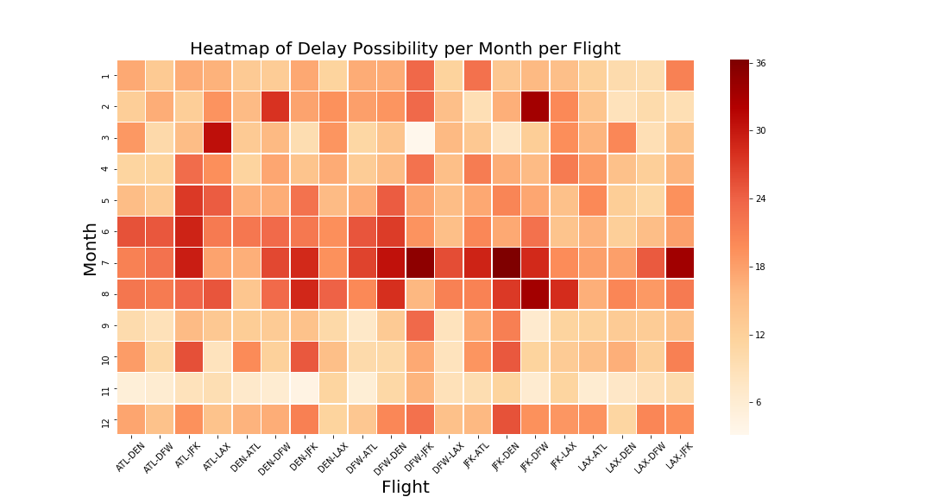

Slide 25
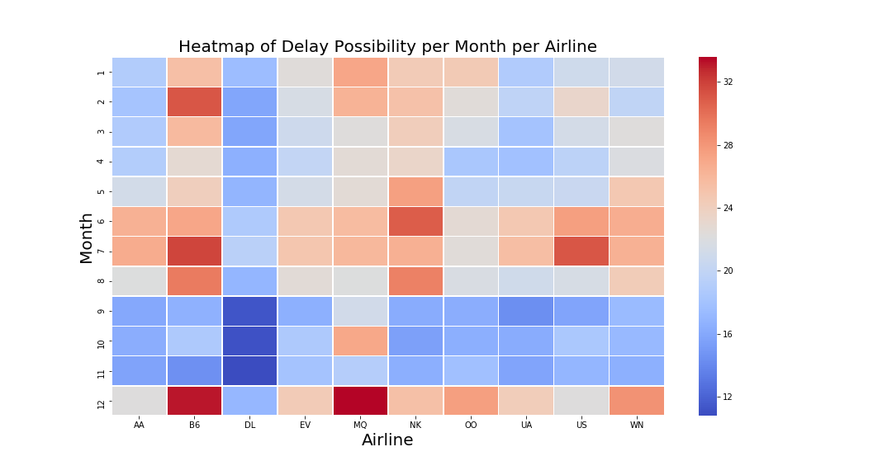

Slide 26
DATA VISUALIZATION/ANALYSIS

Slide 27
LIMITATIONS AND MORE STUFF IF WE HAD MORE TIME
Limitations
Time – identifying a data source with enough information to answer our questions
Additional questions that we wanted to consider if we had more time
Origin and destination analysis
Pricing
Weather impacts
•Thunderstorms •Ceiling and Visibility •In‐flight icing •Turbulence
Airport-focused delay analysis
The cost of delay
Fuel consumption (2007 congressional study estimated 740 million gallons of additional jet fuel was burned due to flight delays, about five percent of total fuel consumption).
Passenger expenses (The 2007 study determined that $16.7 billion was borne by passengers in lost time and additional travel expenses).

Slide 28
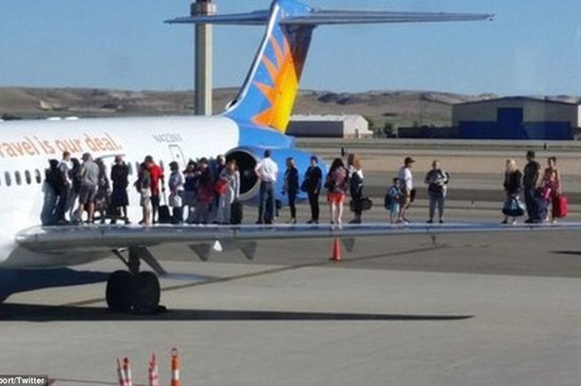
Q & A
This Photo by Unknown Author is licensed under CC BY-SA

